Slide 1
Assignment #2: Camera Obscura
Josh Adams
CS6475 - Fall 2019

Slide 2
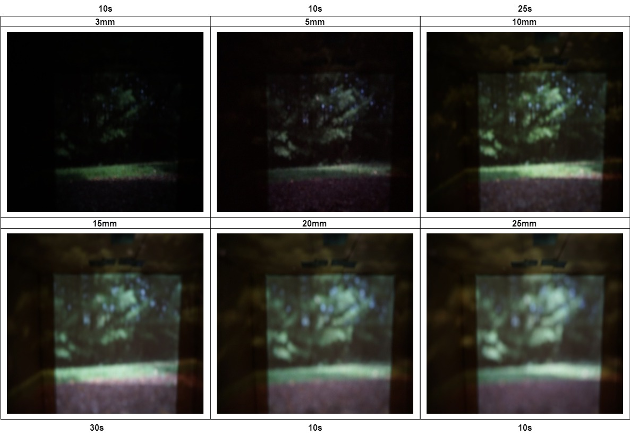
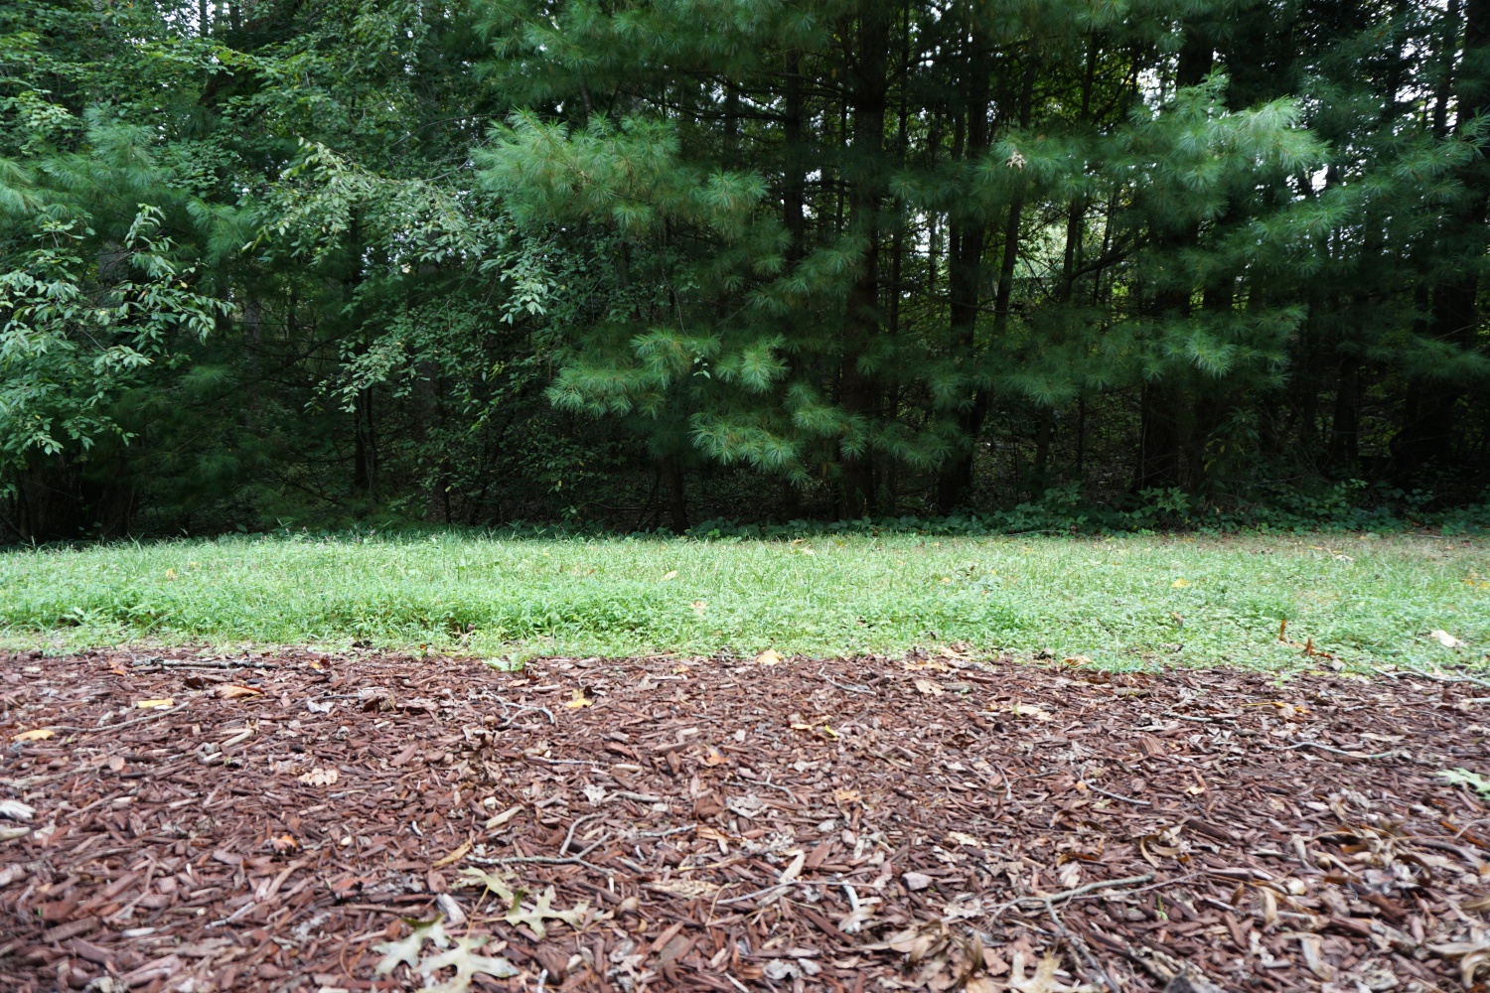
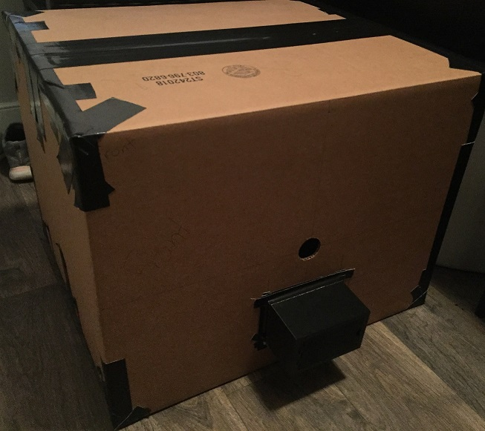
Camera Obscura Project Overview
The Scene
The Final Image
The Setup
Project Summary and Image Descriptions:
The scene is a small wooded area behind my apartment. The final image is of the best exposures and pin hole sizes from the various experiments. My setup was a cardboard box sealed with gorilla tape. I used some 3d printed parts to assist in this experiment.

Slide 3
The Scene - Details
What was the scene of your camera obscura experiment?
The scene for my camera obscura experiment was of a small wooded area. There are many trees in the scene and very little disturbances, such as movement from wind.
What was the site of your camera obscura experiment? In other words, where were you standing when you captured this scene? (e.g. living room)
The site for my camera obscura experiment was behind my apartment. I placed my camera obscura on the ground in a marked location to keep things consistent.
Why was this site appropriate for your camera obscura experiment?
This site was appropriate for my camera obscura experiment because the site does not change much. The reason changing is a concern is that having exposure times from 10s to 30s and if object in the site move, this will introduce artifacts or blurriness.

Slide 4
The Setup - Details
If you constructed a box camera obscura, explain why you were not able to build a room camera obscura.
I have one room where a camera obscura would be possible. All other rooms have too many opportunities for light to enter. It would be a very difficult task to try and cover up all or even most of the ways light could enter in any room other than my bed room.
The problem with my bed room is that it is where both my wife and I sleep. My wife and I have very different schedules. She works night shift and every weekend.
I work until 5:00pm each week day and do not get home until after 6:00pm. This does not leave me with much time for a very bright scene to use for the camera obscura. I am forced to try and construct the camera obscura on a weekend where I will be able to use any part of the day light I wish.
My wife works each weekend so she will be sleeping during the day and I am not going to go in there and disrupt her.

Slide 5
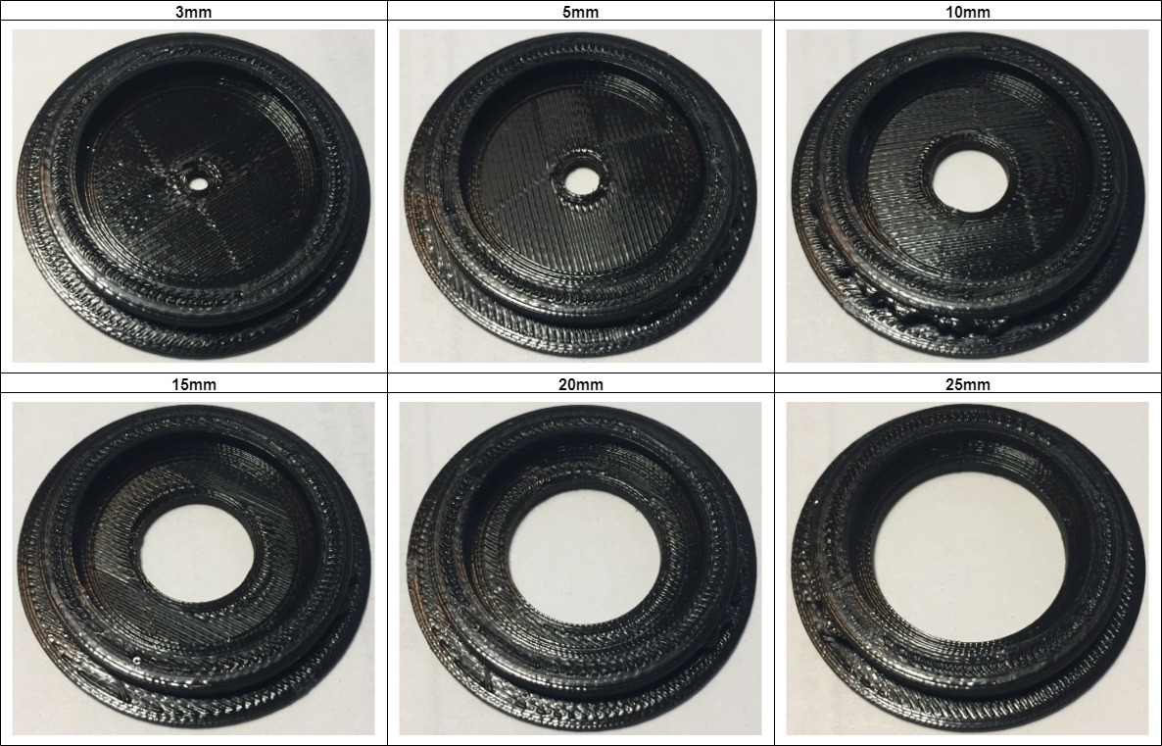
The Setup - Details
Describe & explain the construction of your camera in detail.
I 3d printed out the pin holes so I could have a more controlled setup
I wanted to test the affects the pin hole size make in the resulting image
I made 6 different sized pin holes 25mm, 20mm, 15mm, 10mm, 5mm, 3mm

Slide 6
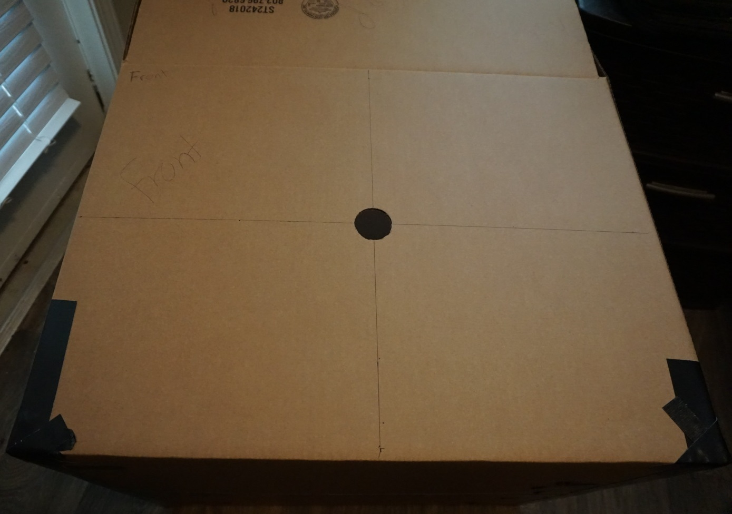
The Setup - Details
Describe & explain the construction of your camera in detail.
I used a cardboard box which was approximately 81cm x 51.5cm x 47cm
I measured and marked of the area where I was going to cut out a hole to place the 3d printed pin holes
I cut the hole using an razor blade

Slide 7
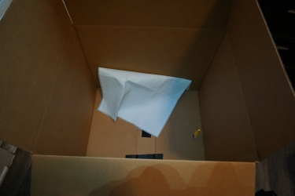
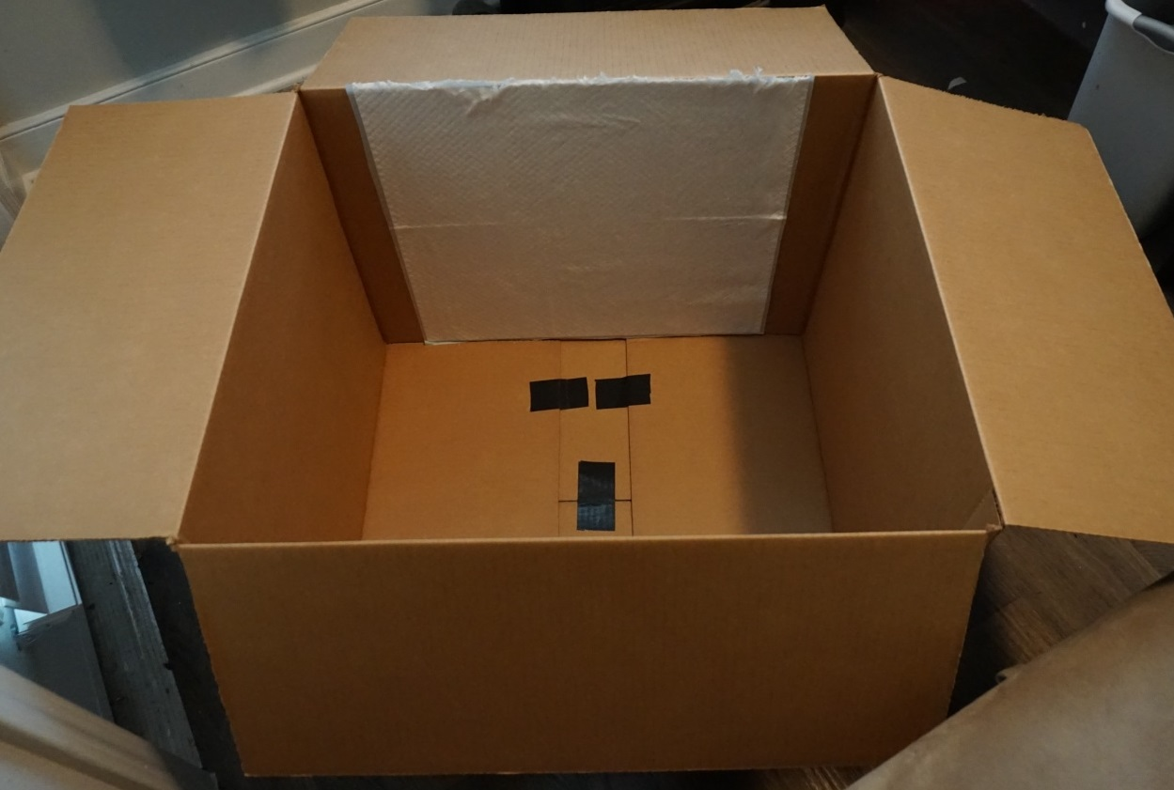
The Setup - Details
Discuss what you used to capture your image on (i.e. screen material)
The back of the cardboard box was not the ideal screen material so I looked for a replacement.
I found a ‘Puppy Pad’ which is a absorbent pad used to potty train puppies. The pad is placed by someone and the puppies are taught to use the bathroom on them.
I covered the internal back wall of the box with the puppy pad. I glued the pad in place. This does add a textured pattern to my results but as with many examples of camera obscura, this can be a desirable effect.

Slide 8
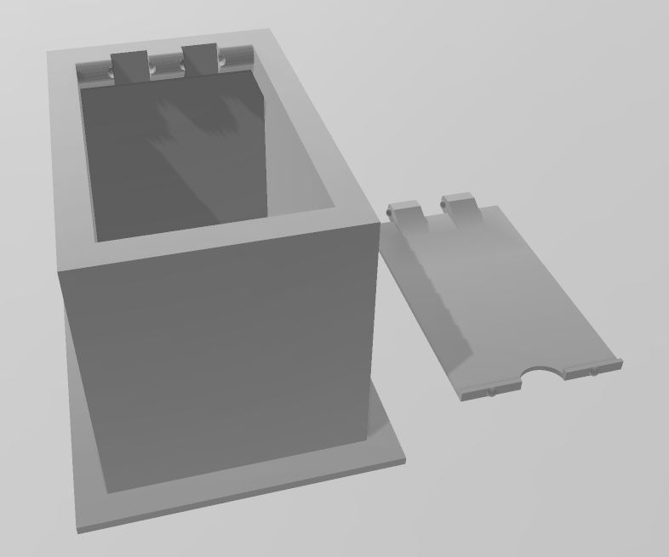
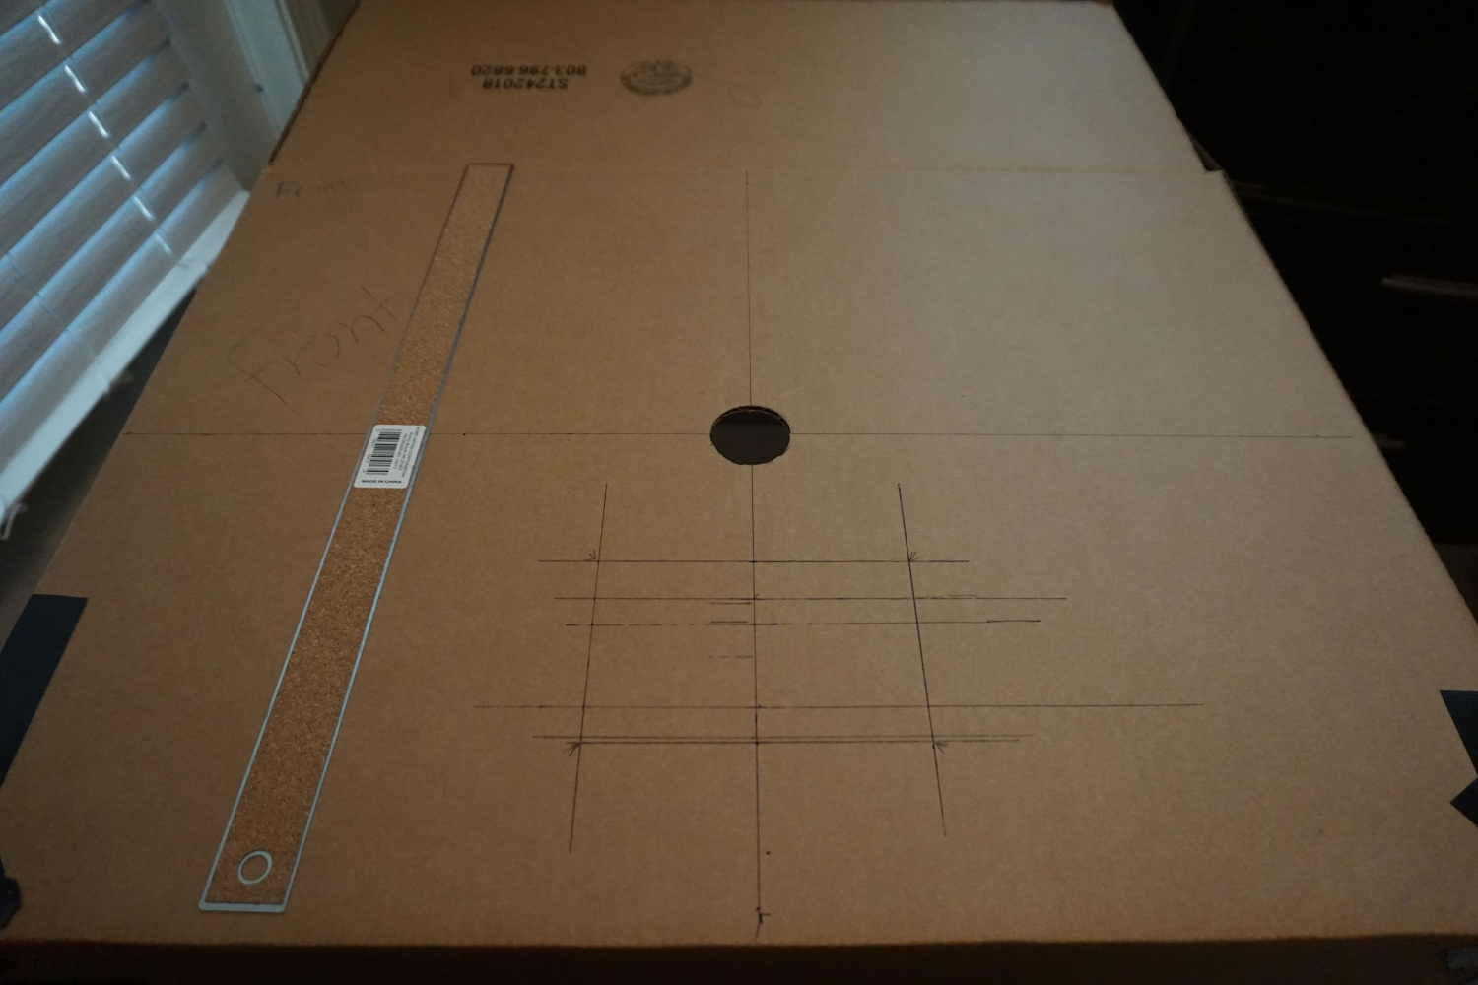
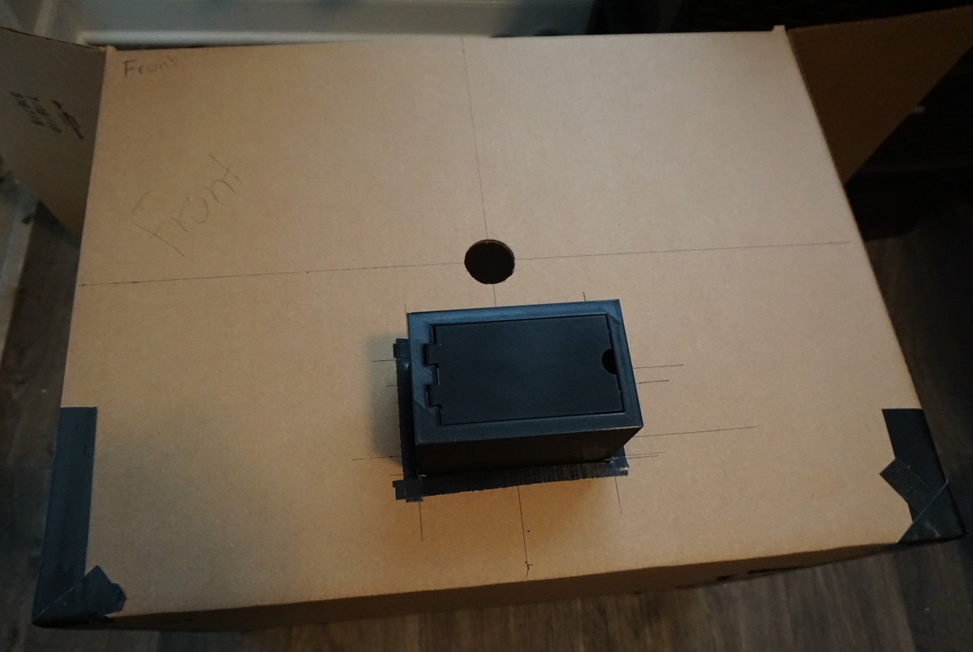
The Setup - Details
Describe & explain the construction of your camera in detail.
I designed a case in 3D builder to hold my camera during the experiment
I 3d printed that case and marked off the area where I would put my camera

Slide 9
The Setup - Details
Describe & explain the construction of your camera in detail.
I sealed up my Sony α5100 inside the box using Gorilla tape ( similar to duct tape )
I controlled my camera remotely using Imaging Edge Mobile

Slide 10
The Setup - Failures
Did you have any initial setups that failed?
I experienced a major failure where all my images were almost too blurry to be used. I spent a long time getting these images the first time and experimenting with all of the different sized pin holes, ISO, and Exposure times. The solution for this issue was to move my camera a little closer within the box. I still was not able to produce as clear of images as we were shown as examples.

Slide 11
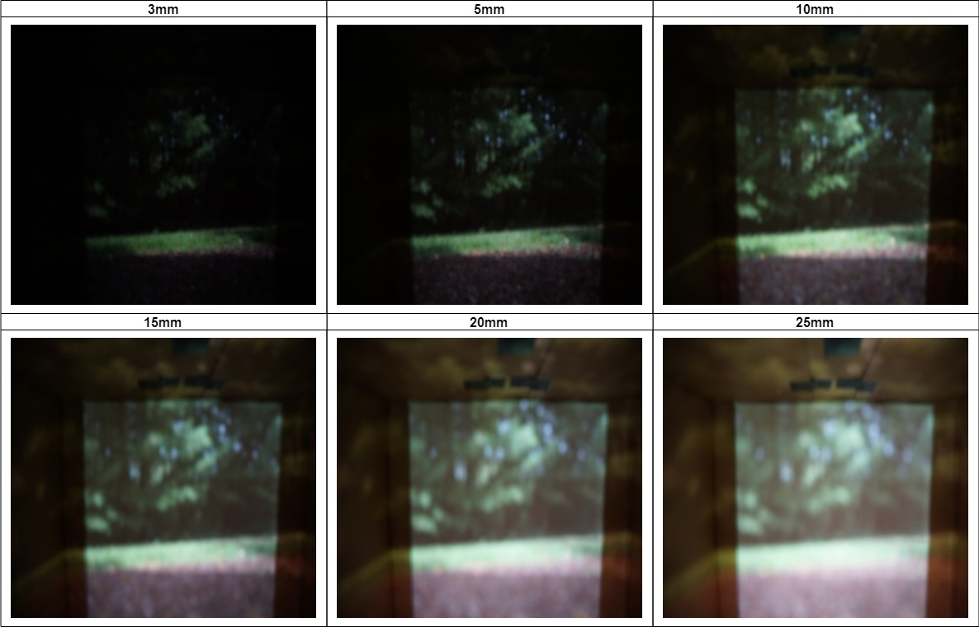
The Final Image(s)
Camera Settings
Shutter Speed: 30 seconds
ISO: 500-100

Slide 12
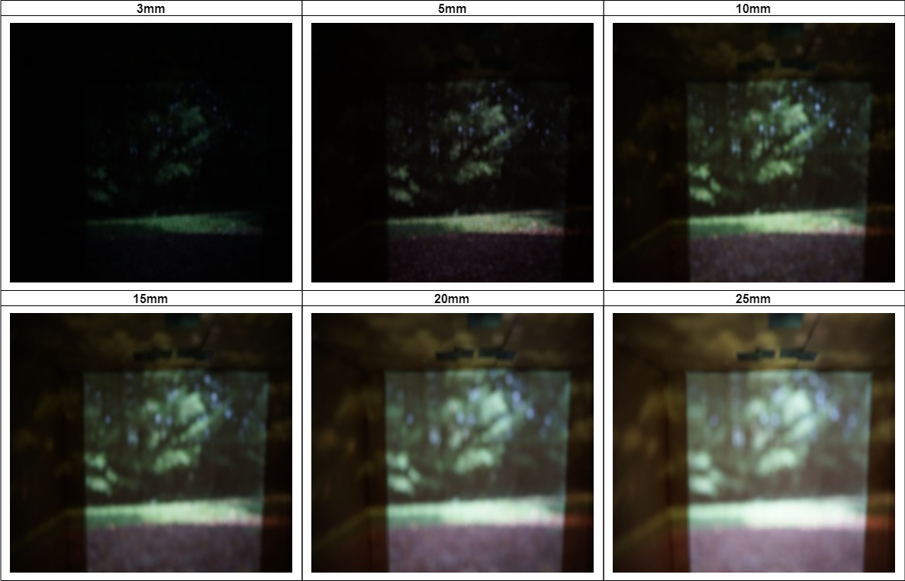
The Final Image(s)
Camera Settings
Shutter Speed: 25 seconds
ISO: 500-100

Slide 13
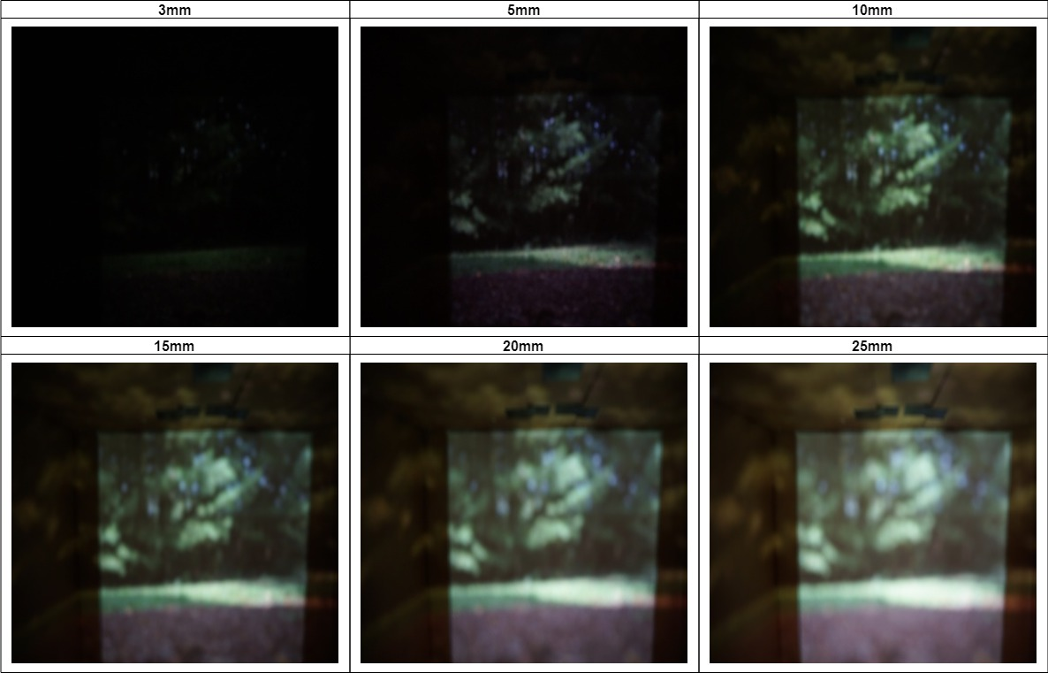
The Final Image(s)
Camera Settings
Shutter Speed: 20 seconds
ISO: 640-100

Slide 14
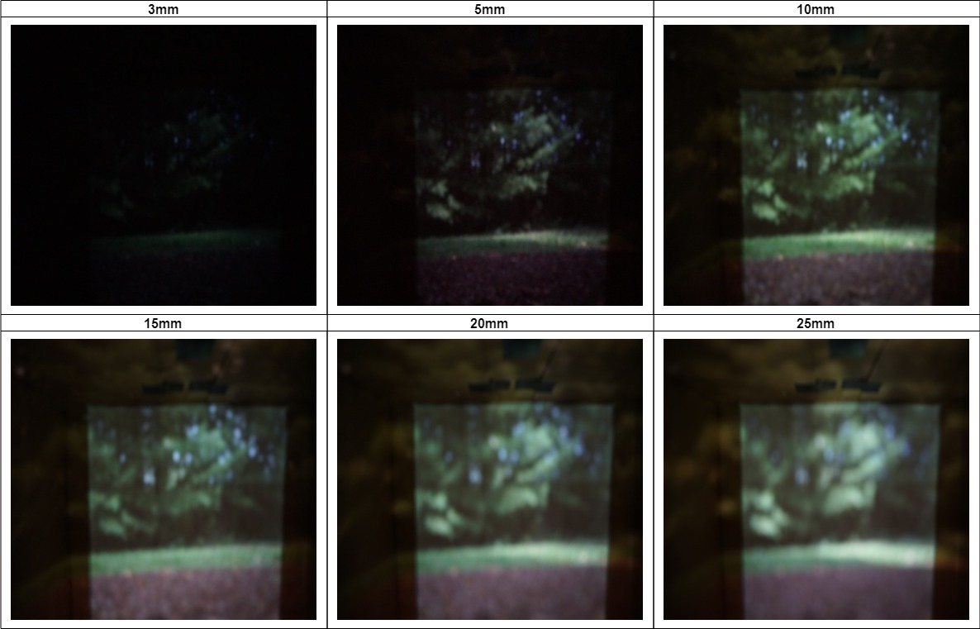
The Final Image(s)
Camera Settings
Shutter Speed: 10 seconds
ISO: 1600-125

Slide 15
The Final Image(s) - Details
Compare your final image with the projection inside the camera obscura viewed with a naked eye. How did your camera settings impact your results? Be sure to discuss what apps or methods you used to control your camera settings.
ISO was something that would impact my results greatly. I attempted to manually control that setting as well but quickly found it overwhelming to keep track of.
I was not able to view the image with a naked eye but using the remote app I was able to see what the camera saw. Comparing the resulting image and the camera obscura, I found the camera obscura to be less defined and less clear.
To control my settings I placed my camera in manual mode so nothing changed. I manually set the exposure time for each group of pin hole sizes I was testing from 30seconds down to 10 seconds. I left ISO on automatic because I have found it typically chooses the best ISO for the lighting conditions
Discuss image enhancement and/or cropping, if used.
For image enhancement I cropped some of the images used in this report using MS Paint
I resized and rotated all obscura images using OpenCv (script included in resources)

Slide 16
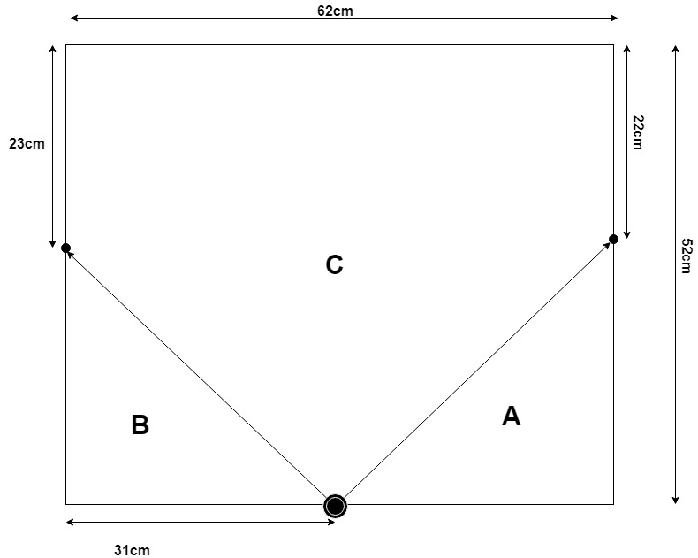

The Final Image(s) – Field of View
What is the camera obscura field of view (FOV) that you observed? Show your work/method.
I calculated the FOV for my camera obscura to be approximately 92.8°
$${A \sim tan}^{−1}\left(\frac{30}{31}\right)=44.0608°$$
$$B \sim \tan^{−1}{(\frac{29}{31})}=43.0908°$$
$$180° −\left(44.0608°+43.0908°\right)=92.8484°$$
$$C \sim 92.8484°$$

Slide 17
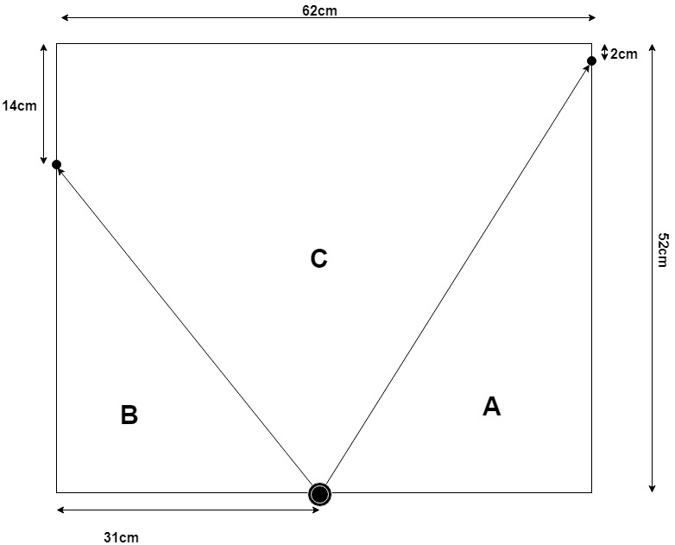

The Final Image(s) – Field of View
What is the FOV for your lens-based digital camera that you used? Show your work/method or say where you got the FOV from.
I calculated the FOV for my digital camera to be approximately 71°
$${A \sim tan}^{−1}\left(\frac{50}{31}\right)=58.2011°$$
$$B \sim \tan^{−1}{(\frac{38}{31})}=50.7928°$$
$$180° −\left(58.2011°+50.7928°\right)=71.0061°$$
$$C \sim 71.0061°$$

Slide 18
The Final Image(s) – Field of View Continued
How does your camera obscura’s FOV compare to the FOV for your lens-based digital camera at the settings used to capture your final image(s)?
The FOV on my camera that I used to capture the images was much more narrow than the camera obscura.
I determined the FOV for my camera was approximately 71°. I measured this by placing markers on the edges of the viewable image for the camera. I then used a protractor to measure the degree for the FOV of my camera to double check my calculations were relatively accurate.
I did the same thing for the Camera Obscura FOV and I measured about a 92.8° FOV. This was much more difficult as I was not able to clearly see the edges of the scene when looking at it with naked eyes.

Slide 19
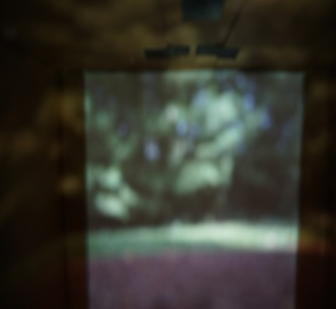
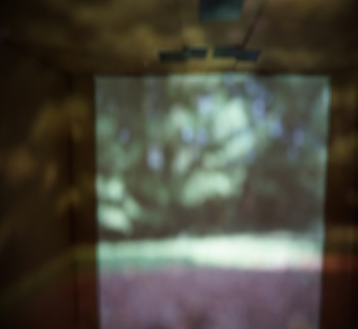
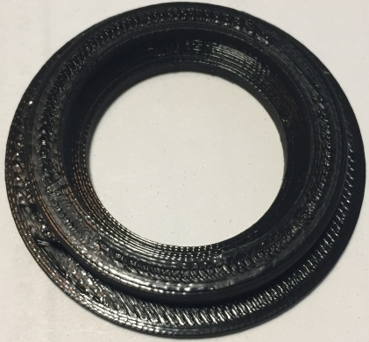
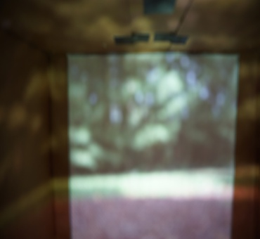
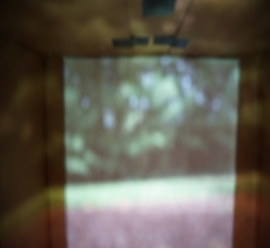
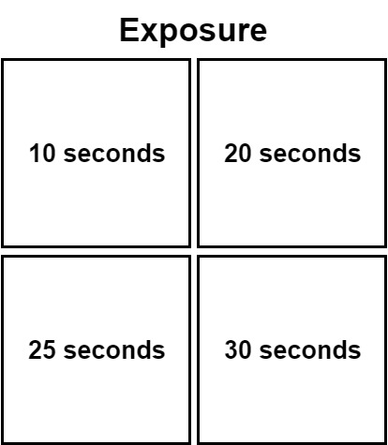
Pinhole Dimensions
Pinhole A dimension: 25mm
This was the largest pin hole I tested, it allowed in the most light. Since we have many overlapping rays of light the image is fairly blurry as expected. Reducing the size of the pin hole will reduce the amount of light that is let through which will reduce the overlap of photons and ultimately produce a more clear image.

Slide 20
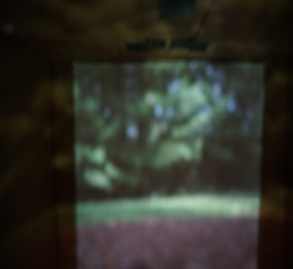
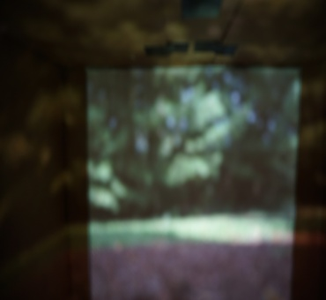
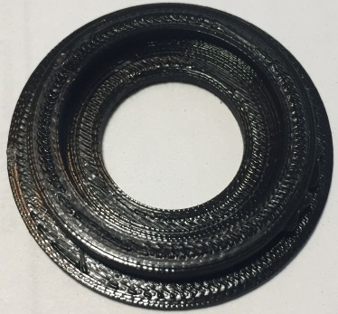
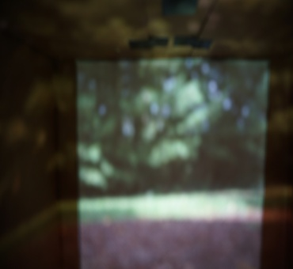
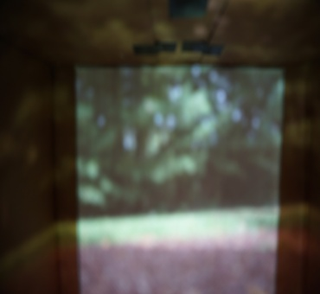
Pinhole Dimensions
Pinhole A dimension: 20mm
I reduced the size of the pin hole from 25mm to 20mm and this reduced the amount of light able to pass through. I am able to see a increase in clarity when going from the 25mm pine hole to the 20mm.

Slide 21
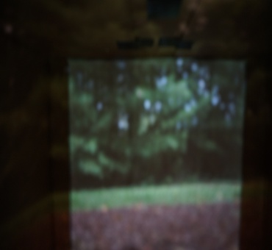
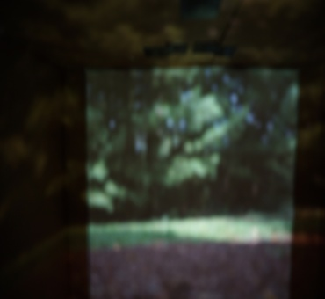
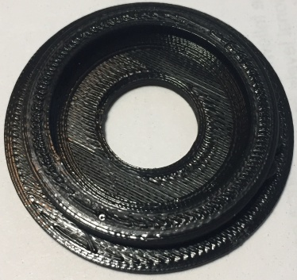
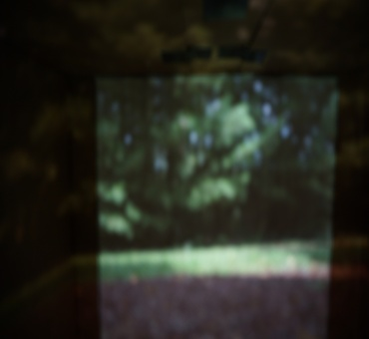
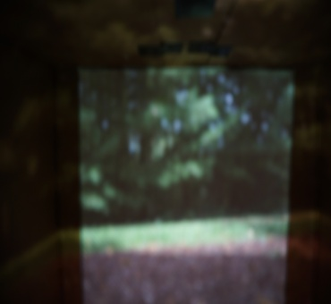
Pinhole Dimensions
Pinhole A dimension: 15mm
This is the 15mm pin hole and the image got darker. As expected the image became more clear than some of the previous experiments with larger pin holes.

Slide 22
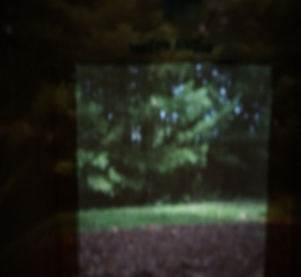
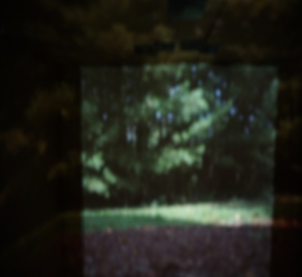
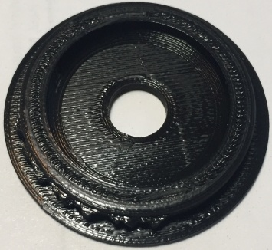
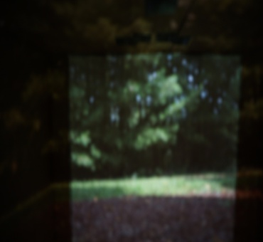
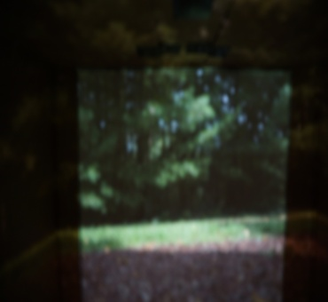
Pinhole Dimensions
Pinhole A dimension: 10mm
This was the 10mm pin hole and I believe it produced the best images overall. I expected that if I reduced the pin hole size further it would increase clarity but I had mixed results when reducing the diameter of the pin hole.

Slide 23
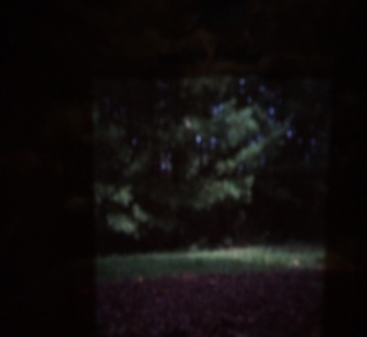
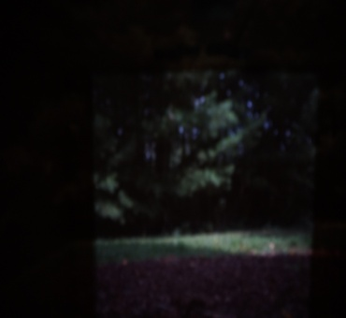
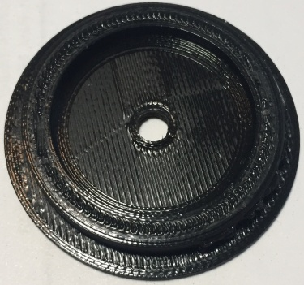
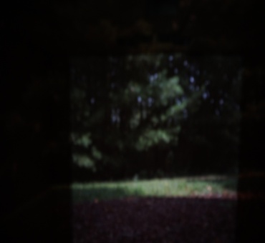
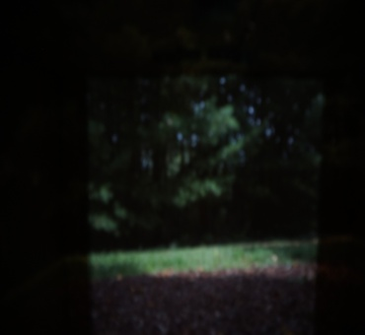
Pinhole Dimensions
Pinhole A dimension: 5mm
This was the 5mm pin hole and I was surprised how going from a 10second exposure (top-left) to a 30second (bottom-right) did not make as much of a difference as I expected.

Slide 24
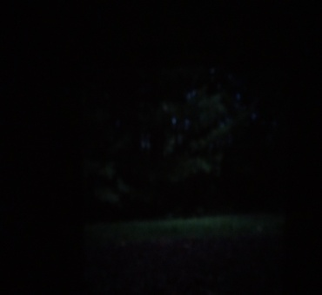
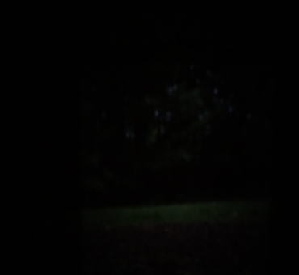
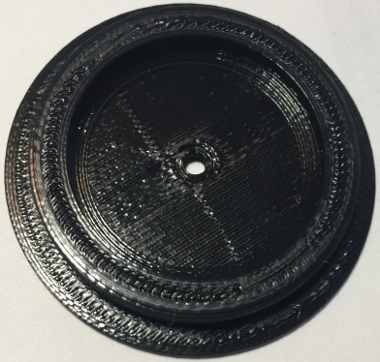
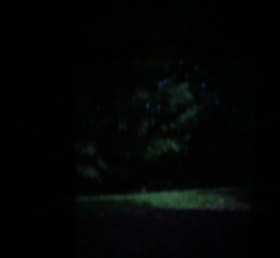
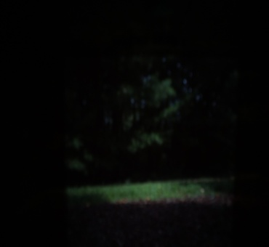
Pinhole Dimensions
Pinhole A dimension: 3mm
This was the smallest pin hole I tested and it is clear that not much light is allowed to pass through the hole. I expected the image to get clearer the smaller I went with the hole size, but I do not observe more clarity from the 3mm over the 5mm pin hole.

Slide 25
Pinhole Dimensions - Details
What did you learn from this pinhole experiment?
I learned the pin hole size affects the obscura image in many ways
I learned about the pin hole limiting the light causes the image to be upside down due to the angle at which the light is able to make it through to the back of the box.
The higher the object is in the real scene the lower it will be on the obscura display.
I learned the larger the pin hole the more light is allowed to pass through which ultimately causes the images to be more blurry as the light rays overlap.
I learned you need to experiment a lot to produce great results with camera obscura

Slide 26
Project Retrospective
What were you happy with about your project? Discuss.
I was really happy I was able to weave in one of my hobbies, 3d printing, into this project. I find 3d printing to be very interesting as you can just make something you need in only minutes to hours. I needed regulated pin holes, so I designed and printed them out. I needed a case for my camera, so I designed and printed one out.
Another thing I was happy about with this project was exploring new things, such as the camera obscura. I found it very interesting how the scene is just projected onto the back wall of the box. I also found it interesting how the images display upside down, due to the angle of the light that travels through the pin hole.
If you were to repeat the project, is there anything you would do differently knowing what you know now? Discuss.
If I were to repeat this project I would avoid my failure of having my camera too far away from the screen in my camera obscura. Knowing this would saved me a lot of time and effort.

Slide 27
Resources
https://padumedu.files.wordpress.com/2013/12/alhazen.jpg
https://upload.wikimedia.org/wikipedia/commons/8/8a/Camera_obscura2.jpg
https://github.gatech.edu/omscs6475/assignments/tree/master/A2-Camera_Obscura
http://www.janetneuhauser.com/thoughts-on-lensless-photography/
https://www.youtube.com/watch?v=Y0wenfVfHuo
https://www.scratchapixel.com/lessons/3d-basic-rendering/3d-viewing-pinhole-camera
https://www.draw.io/ - Used to make pin hole chart
https://en.wikipedia.org/wiki/Inverse_trigonometric_functions – Calculating FOV
Microsoft Paint – Used to crop/resize some images
Microsoft 3D Builder – Used to create the 3d models that I printed for this assignment
Sony α5100 – My Camera
Imaging Edge Mobile– Used to control the camera once the camera was sealed within the box

